Slide 1
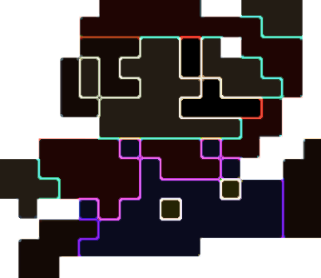
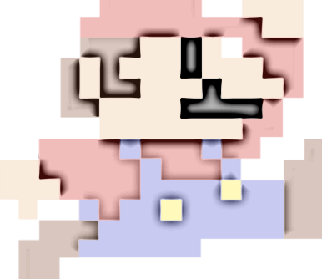
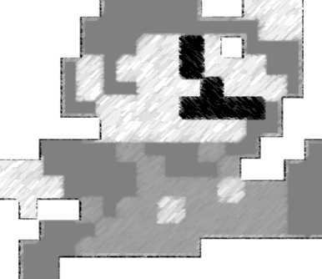
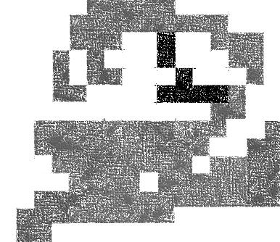
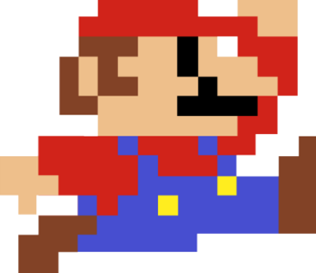
Image Processing Algorithms
By Joe Trobisch
Notes:
https://softwarebydefault.com/2013/06/30/stained-glass-image-filter/

Slide 2
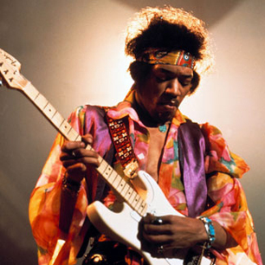
What is a pixel?
Computers represent images using hundreds of thousands of pixels
Computerised images are often referred to as ‘bitmap’ images

Slide 3
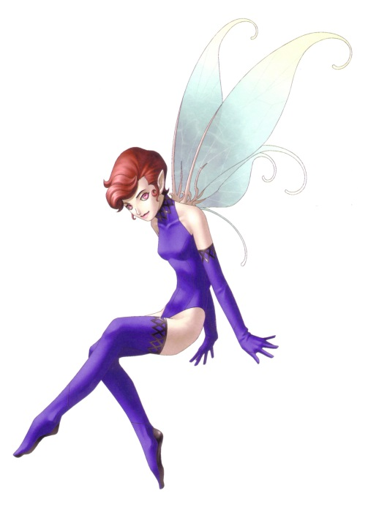
A Pixel in the Making…
To be a pixel, you must have;
A blue value (0 -255)
A green value (0 -255)
A red value (0 -255)
An alpha value (0 -255) (Transparency)
This is often referred to as an RGB colour, although a computer stores it as BGR
A pixel is made up of 4 bytes of data
A byte has a positive range between 0 to 255
256 * 256 * 256 = 16,777,216 possible colours!
34 (B)
40 (G) 50 (R) 255 (A)

Slide 4
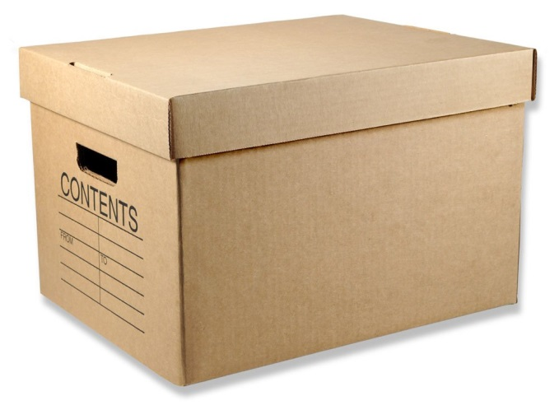
Storing Pixels
Pixel 1
b
g
r
a
12
76
0
0
42
55
87
9
4
87
43
93
99
0
0
91
3
46
96
10
3
2
46
88
47
4
96
4
45
28
9
94
A bitmap image simply stores all of its pixels in a byte array – byte[]
This means that every 5th value in the array is the beginning of a new pixel
Pixels do not have co-ordinate values – when the pixel data reaches the width of the image, the data simply begins the next line in the image

Slide 5
Image Processing Algorithms
An image processing algorithm is a technique that is used to manipulate each pixel in the byte array to create a ‘new effect’
For example;

Slide 6
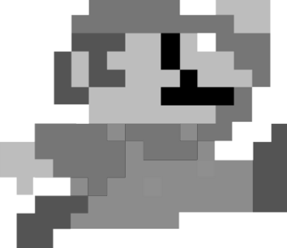
Grey Scale
Pixel 1
Pixel 2
b
g
r
a
b
g
r
a
10
20
30
99
5
10
15
99
Pixel 1
Pixel 2
Avg = 10 + 20 + 30 / 3
b
g
r
a
b
g
r
a
20
20
20
99
10
10
10
99
Grey scale is generally an easy algorithm to implement
There are several algorithms that can be used
The easiest is known as ‘averaging;’
Grey = (Red + Green + Blue) / 3

Slide 7
Grey Scale With Use Input
To enable the user to determine the degree of the grey that is implied, then use this formula;
Degree = 255 / User_Input (between 1 and 255)
Average = (Red + Green + Blue) / 3
Grey = (Byte) Average / Degree )

Slide 8
Other Grey Scale Algorithms
Luminance;
Grey = (Red * 0.3 + Green * 0.59 + Blue * 0.11)
Desaturation;
Grey = (Max(Red, Green, Blue) + Min(Red, Green, Blue) ) / 2
Max Decomposition;
Grey = Max(Red, Green, Blue)
Min Decomposition;
Grey = Min(Red, Green, Blue)
Single Colour Channel;
i.e. Grey = Red or Grey = Green or Grey = Blue

Slide 9
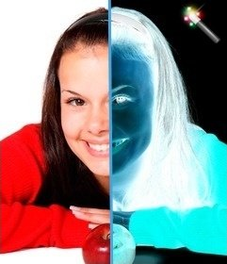
Colour Invert
Colour inversion is another easy algorithm to write
Colour inversion reverses the colour ranges turning the image into a ‘negative’

Slide 10
Colour Invert Algorithm
To calculate the new colour ranges, simply take each colour value and subtract it from 255; the algorithm is shown below;
Red = 255 – Red (Current Value) Green = 255 – Green (Current Value) Blue = 255 – Blue (Current Value)

Slide 11
Other Colour Inversions
Blue Invert;
Red = Red Green = Green Blue = 255 – Blue
Green Invert;
Red = Red Green = 255 - Green Blue = Blue
Red Invert;
Red = 255 - Red Green = Green Blue = Blue

Slide 12
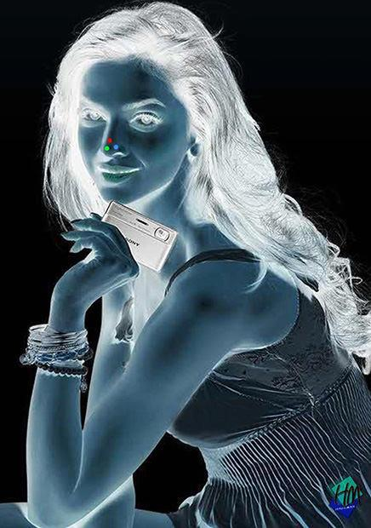
More Colour Inversions
Blue Red Invert;
Red = 255 - Red Green = Green Blue = 255 – Blue
Blue Green Invert;
Red = Red Green = 255 - Green Blue = 255 - Blue
Red Green Invert;
Red = 255 - Red Green = 255 - Green Blue = Blue

Slide 13
Threshold / Black & White
A ‘threshold’ effect is a common name for making an image black and white
The threshold algorithm changes the colour values (RGB) of each pixel to either 0 or 255 based on their current value
This results in a pixel being black (0,0,0) or white (255,255,255)

Slide 14
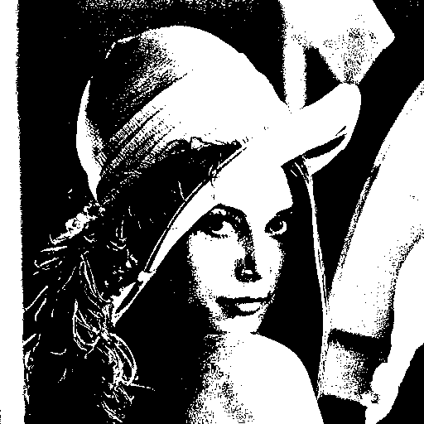
Threshold Algorithm
The ‘threshold’ is generally set to the midway point, which is 127.5
If Blue < 128 Then
Blue = 0
Green = 0
Red = 0
Else
Blue = 255
Green = 255
Red = 255

Slide 15
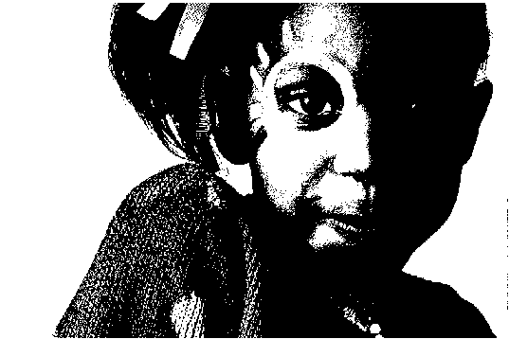
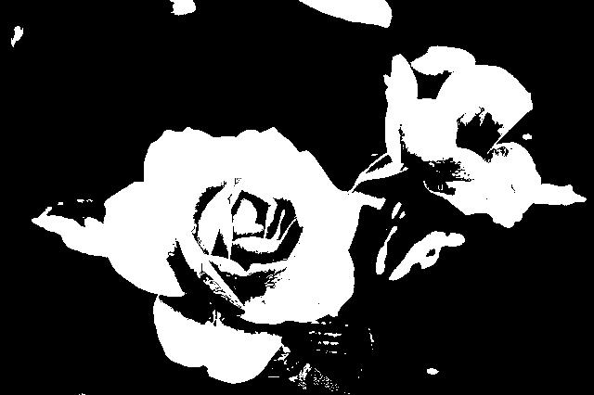
Threshold With User Input
The threshold can be adjusted (set by the user [recommended between 20 and 235]) to change the output of the image. The algorithm would now be expressed as;
If Blue < User_Input Then
Blue = 0
Green = 0
Red = 0
Else
Blue = 255
Green = 255
Red = 255

Slide 16
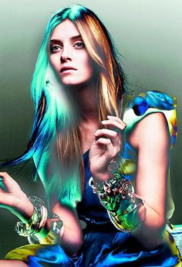
Solarise
Solarise, to a degree, is similar to colour inversion, but the results are quite different and are certainly interesting

Slide 17
Solarise Algorithm
The solarise algorithm could be expressed as;
If Red < 128 Then
Red = 255 - Red Else Red = Red
If Green < 128 Then
Green = 255 - Green Else Green = Green
If Blue < 128 Then
Blue = 255 - Blue Else Blue = Blue

Slide 18
Solarise With User Input
Again, like the other algorithms, the effect can be manipulated with user input, by changing the ‘threshold’ value (between 0 and 255);
If Red < User_Input Then
Red = 255 - Red Else Red = Red
If Green < User_Input Then
Green = 255 - Green Else Green = Green
If Blue < User_Input Then
Blue = 255 - Blue Else Blue = Blue

Slide 19
Colour Adjust/Balance
As the name suggests, it is possible to adjust the colours that appear in an image, by manually tweaking the red, green and blue values that are set for each pixel
The definition; a colour balance is the global adjustment of the intensities of the colours

Slide 20
Colour Adjust Algorithm
Factor Between 0 and 2
i.e. 0 would remove all colour, 2 would increase it by 100%, 1.5 would increase by 50%, 0.6 would reduce it by 40%
Red = Factor * Red (Current Value)
Or Green = Factor * Green (Current Value)
Or Blue = Factor * Blue (Current Value)
Notes:
R = 255 / R_{w} * R¹
G = 255 / G_{w} * G¹
B = 255 / B_{w} * B¹

Slide 21
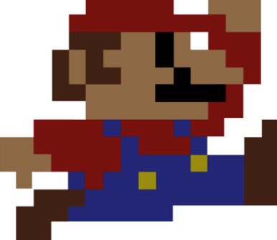
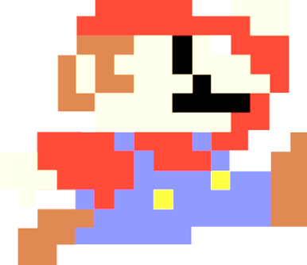
Contrast
Contrast is the difference in luminance or colour that makes an object (or its representation in an image or display) distinguishable
In other words, it darkens or lightens an image

Slide 22
Contrast Algorithm
C = ((100.0 + T) / 100.0)²
T represents the variable threshold
Red = ( ( ( (Red (Cur Val)/ 255.0) – 0.5) * C) + 0.5) * 255.0
Green = ( ( ( (Green (Cur Val) / 255.0) – 0.5) * C) + 0.5) * 255.0
Blue = ( ( ( (Blue (Cur Val)/ 255.0) – 0.5) * C) + 0.5) * 255.0

Slide 23
Using Matrices
All of the previous algorithms are simple image processing algorithms
To yield better results, more complex algorithms are required
For example, a matrix (Image Kernel) can be used to create edge detection, sharpen and blur algorithms
This is called Kernel Convolution

Slide 24
Kernel Convolution
Convolution is the process of adding each element of the image to its local neighbours, weighted by the kernel
For example, if we have two three-by-three matrices, one a kernel, and the other an image piece, convolution is the process of flipping both the rows and columns of the kernel and then multiplying locationally similar entries and summing

Slide 25

Kernel Convolution Formula

Slide 26
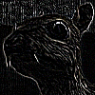

Edge Detection Kernel Matrix

Slide 27
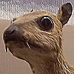

Sharpen Kernel Matrix

Slide 28
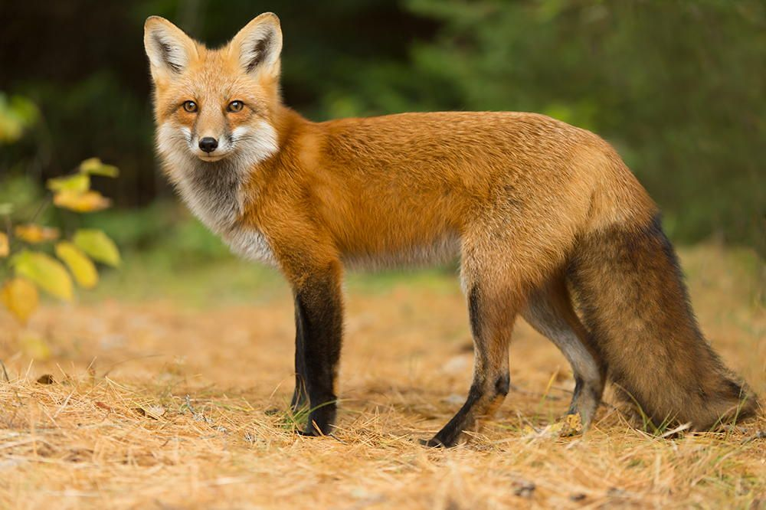
Find Surrounding Pixels First
(Index – row) - 1 | (Index – row) | (Index – row) +1
Index -1 | Index | Index +1
(Index + row) -1 | (Index + row) | Index + row) + 1
TIP: write a function that will return all of the surrounding pixels (including the centre pixel) of the selected pixel and store them in a list<pixel>
Once you have the surrounding pixels, the matrix can be applied

Slide 29
Apply Matrix to Surrounding Pixels
(Index – row) - 1 | (Index – row) | (Index – row) +1
Index -1 | Index | Index +1
(Index + row) -1 | (Index + row) | Index + row) + 1
RedTotal += PIXEL: Red Value * 0
GreenTotal += PIXEL: Green Value * 0
BlueTotal += PIXEL: Blue Value * 0

Slide 30
Apply Matrix to Surrounding Pixels
(Index – row) - 1 | (Index – row) | (Index – row) +1
Index -1 | Index | Index +1
(Index + row) -1 | (Index + row) | Index + row) + 1
RedTotal += PIXEL: Red Value * -1
GreenTotal += PIXEL: Green Value * -1
BlueTotal += PIXEL: Blue Value * -1

Slide 31
Apply Matrix to Surrounding Pixels
(Index – row) - 1 | (Index – row) | (Index – row) +1
Index -1 | Index | Index +1
(Index + row) -1 | (Index + row) | Index + row) + 1
RedTotal += PIXEL: Red Value * 0
GreenTotal += PIXEL: Green Value * 0
BlueTotal += PIXEL: Blue Value * 0

Slide 32
Apply Matrix to Surrounding Pixels
(Index – row) - 1 | (Index – row) | (Index – row) +1
Index -1 | Index | Index +1
(Index + row) -1 | (Index + row) | Index + row) + 1
RedTotal += PIXEL: Red Value * -1
GreenTotal += PIXEL: Green Value * -1
BlueTotal += PIXEL: Blue Value * -1

Slide 33
Apply Matrix to Surrounding Pixels
(Index – row) - 1 | (Index – row) | (Index – row) +1
Index -1 | Index | Index +1
(Index + row) -1 | (Index + row) | Index + row) + 1
RedTotal += PIXEL: Red Value * 5
GreenTotal += PIXEL: Green Value * 5
BlueTotal += PIXEL: Blue Value * 5

Slide 34
Set Centre Pixel Values and Then Simply Move On
Once the red, green and blue totals have been calculated for the whole matrix, simply set the centre pixel with its new value;
Pixel (Centre Pixel) Red = RedTotal
Pixel (Centre Pixel) Green = GreenTotal
Pixel (Centre Pixel) Blue = BlueTotal
Now simply repeat the process for the next pixel in the image, until all pixels have been manipulated

Slide 35
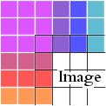
Corners and Edges
Kernel convolution usually requires values from pixels outside of the image boundaries. There are a variety of methods for handling image edges;
Extend
The nearest border pixels are conceptually extended as far as necessary to provide values for the convolution. Corner pixels are extended in 90° wedges. Other edge pixels are extended in lines
Wrap
The image is conceptually wrapped (or tiled) and values are taken from the opposite edge or corner
Crop
Any pixel in the output image which would require values from beyond the edge is skipped. This method can result in the output image being slightly smaller, with the edges having been cropped.

